Slide 1



Search Engine
Search

Slide 2

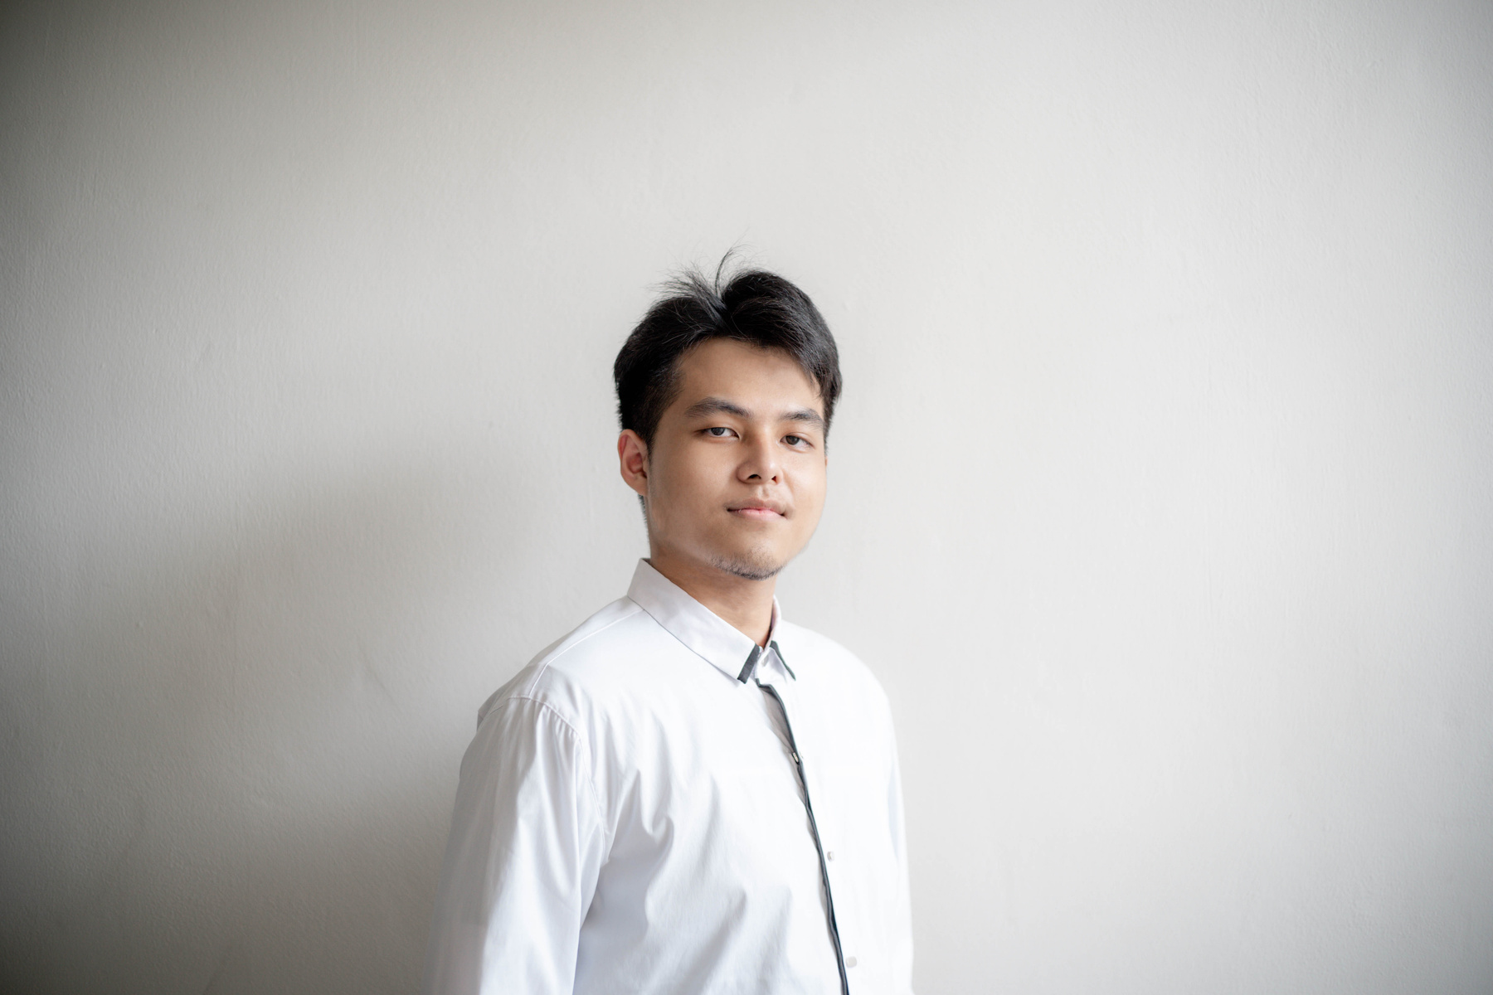
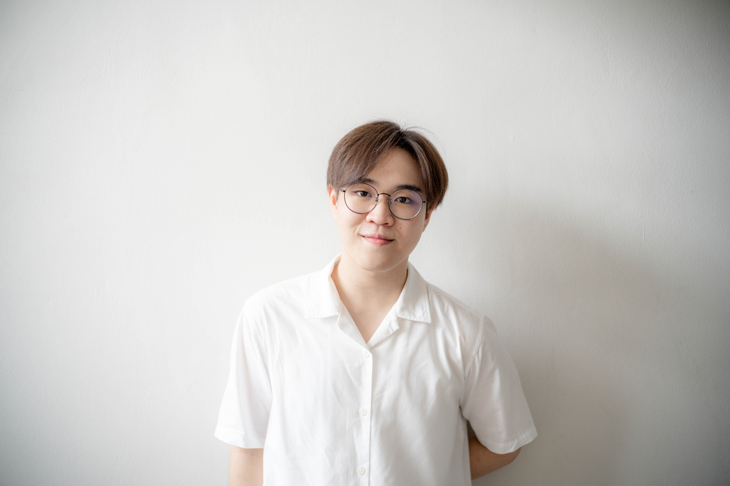

THIS IS OUR TEAM
Kittitad Jiraprasitchai
6288073
Chancheep Mahacharoensuk
6288092
Kantapong Matangkarat
6288160

Slide 3




Topics
Demonstration of your search system
Technical Use

Slide 4
ALL THE COMPONENTS WE USE

Slide 5




Slide 6
HOW TO RUN

Slide 7
1.RUN"ELASTICSEARCH.BAT''
2.RUN"KIBANA.BAT''
3.RUN"FLASK RUN''

Slide 8
DEMO

Slide 9

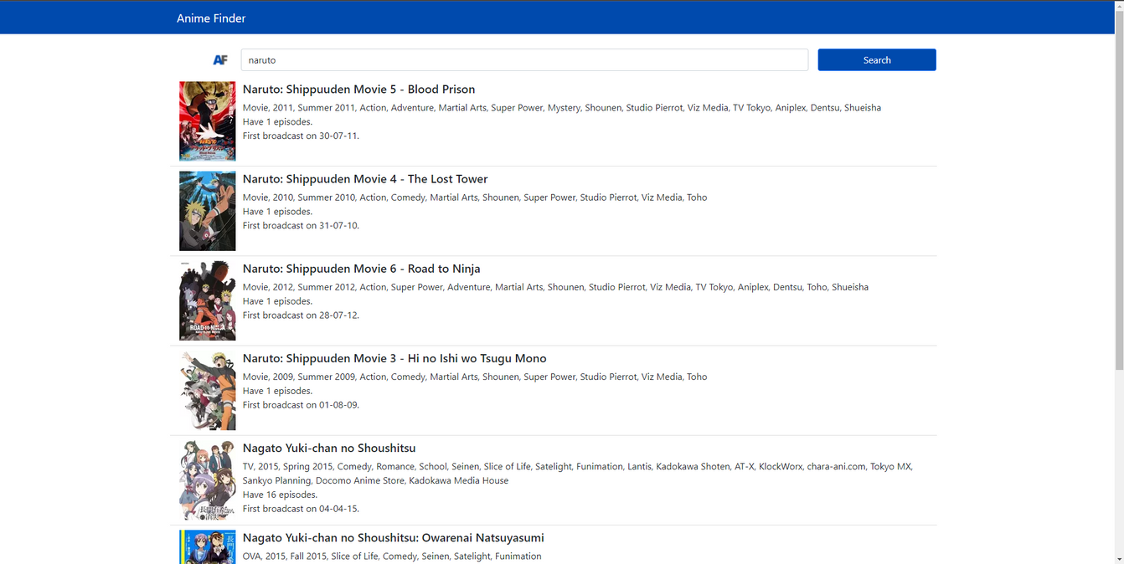
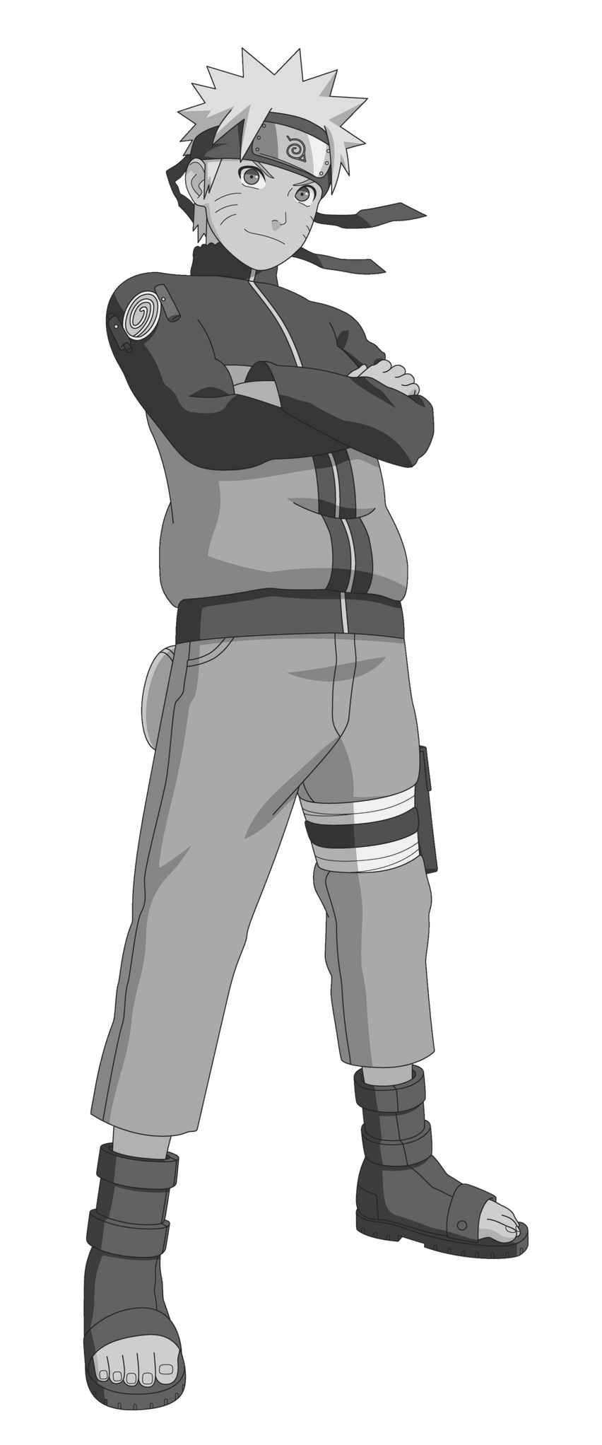

MAIN PAGE

Slide 10
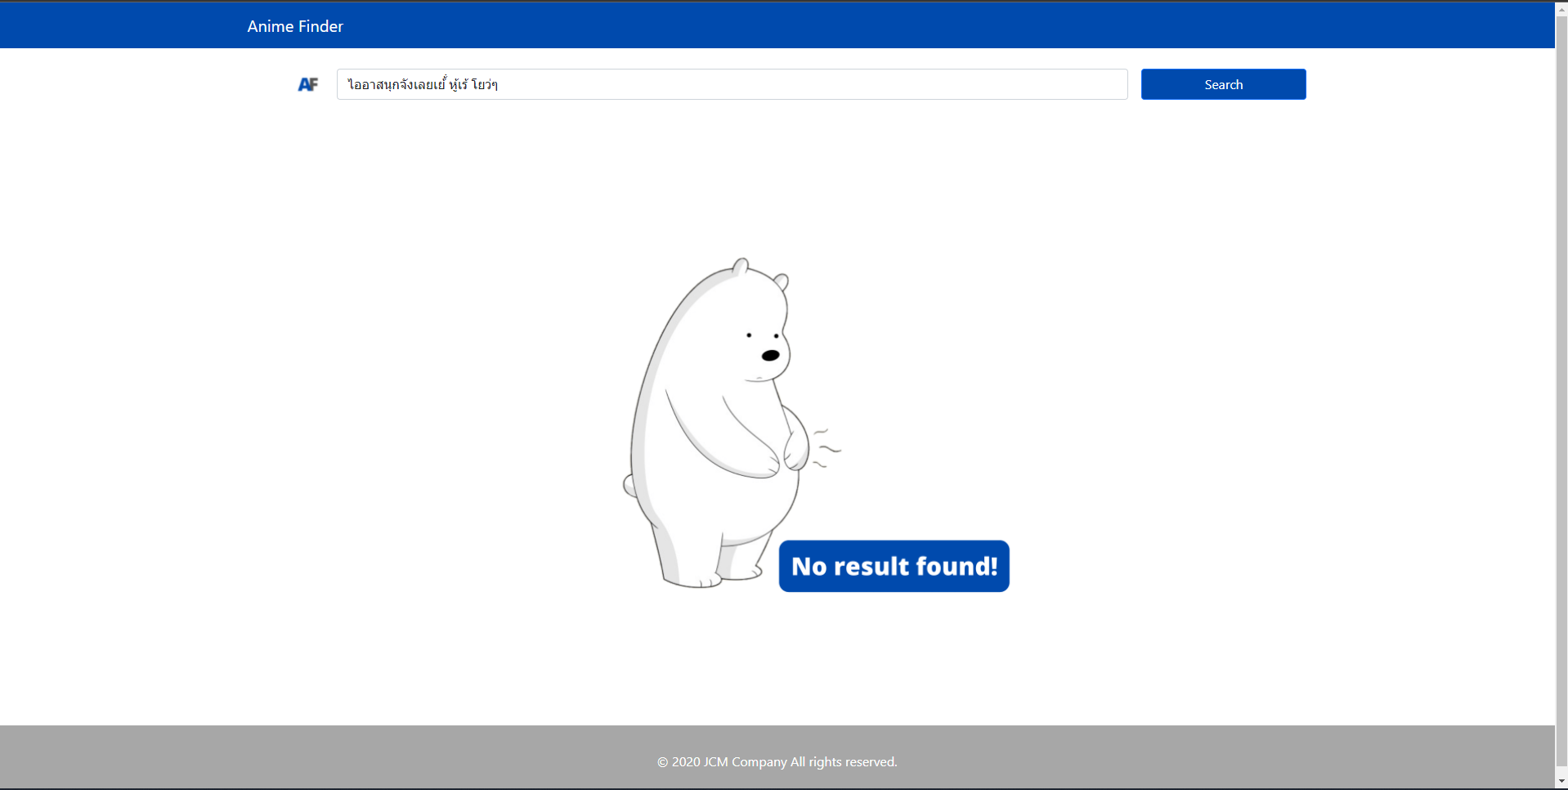
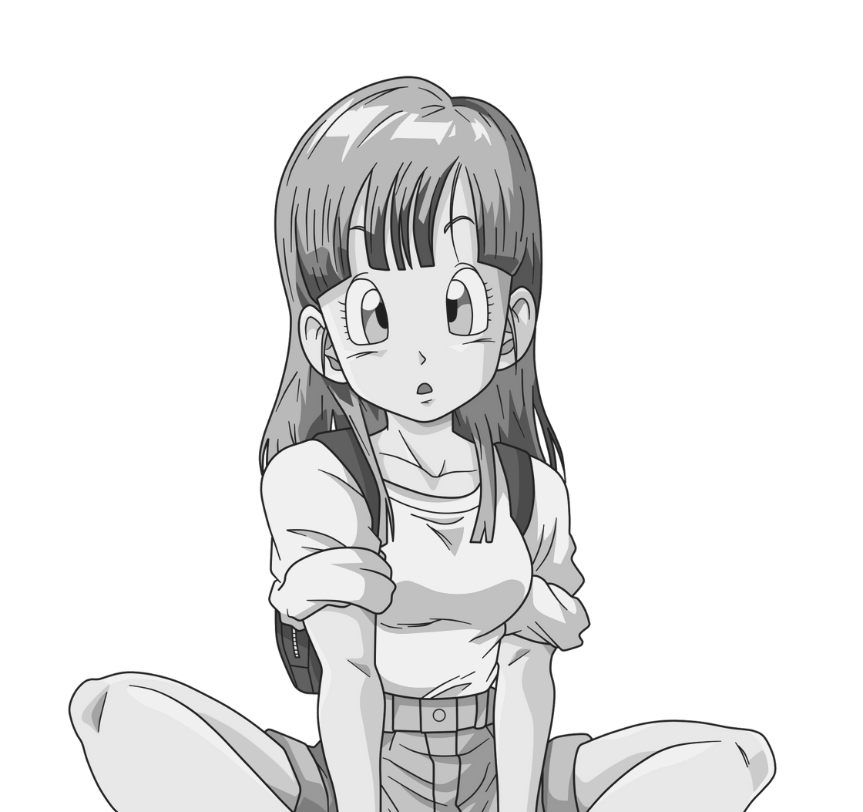
NO RESULT!!

Slide 11

TYPE JUST
"a"

Slide 12
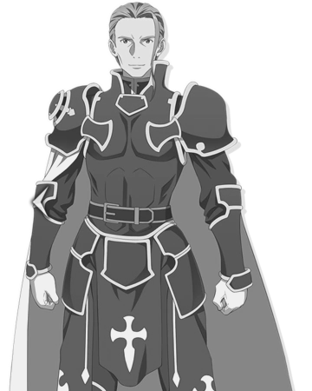
TYPE
"naruto"

Slide 13

TYPE
"naruto"
WRONG TO
"naruutuu"

Slide 14
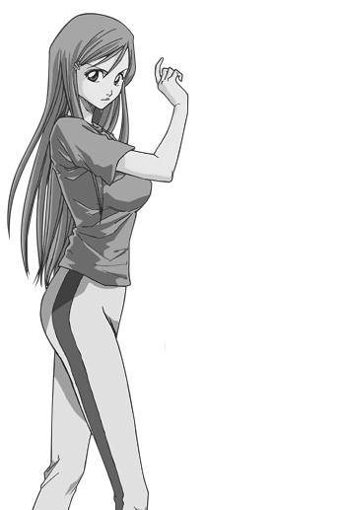
TYPE
SOMETHING
THAT NOT EXIST

Slide 15
TECHNICAL USE

Slide 16
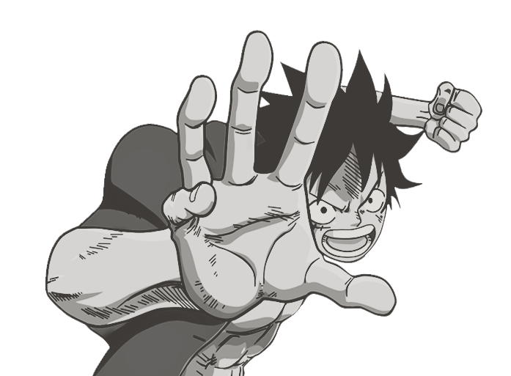
ELASTICSEARCH

Slide 17


JSON DOCUMENT

Slide 18
KIBANA

Slide 19


INVERTED INDEX
TF/IDF

Slide 20


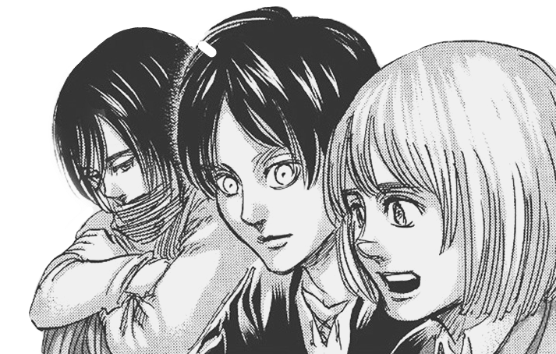
HTML
PYTHON

Slide 21

Thank you!

